Slide 1
Seminar aus Künstliche Intelligenz
Nikolay Dimitrov
R-max – A General Polynomial Time Algorithm for Near-Optimal Reinforcement Learning

Slide 2
Overview
Exploration vs Exploitation Dilemma
Stochastic Games
R-max
Conclusion

Slide 3
Exploration vs Exploitation Dilemma
Exploitation: make the best decision given current information
Exploration: gather more information
The best long-term strategy may involve short-term sacrifices
Gather enough information to make the best overall decisions

Slide 4
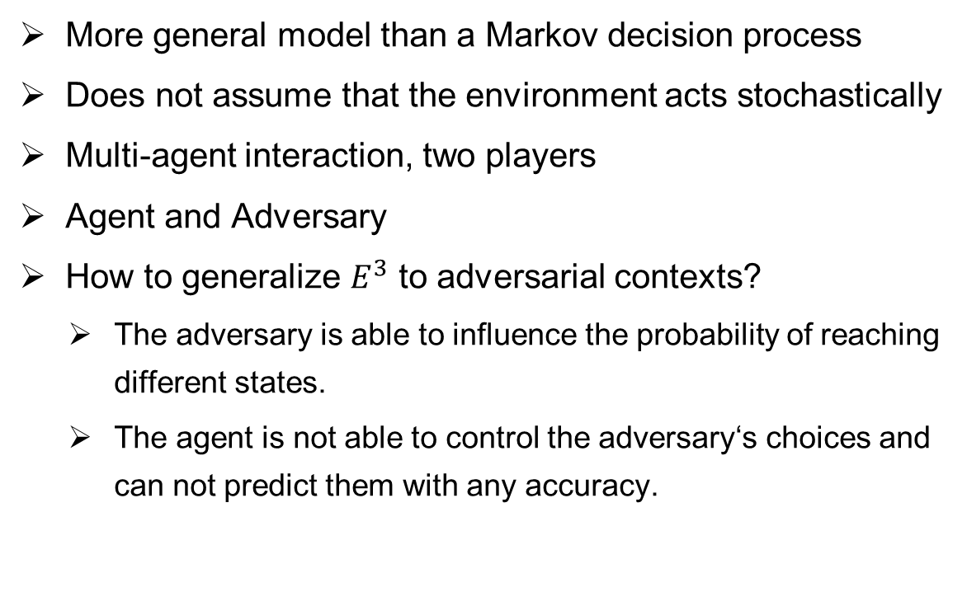
Stochastic Game
More general model than a Markov decision process
Does not assume that the environment acts stochastically
Multi-agent interaction, two players
Agent and Adversary
How to generalize $E^{3}$ to adversarial contexts?
    The adversary is able to influence the probability of reaching different states.
    The agent is not able to control the adversary‘s choices and can not predict them with any accuracy.

Slide 5
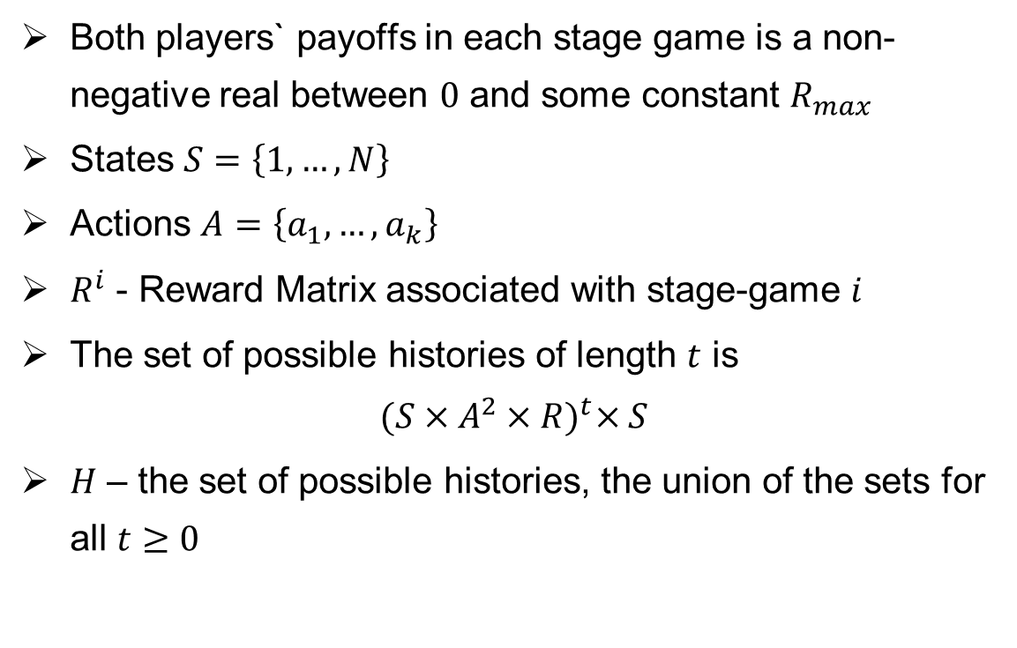
Stochastic Game
Both players` payoffs in each stage game is a non-negative real between $0$ and some constant $R_{max}$
States $S=\left\{1,…,N\right\}$
Actions $A=\left\{a_{1},…,a_{k}\right\}$
$R^{i}$ - Reward Matrix associated with stage-game $i$
The set of possible histories of length $t$ is
$${(S×A^{2}×R)}^{t}×S$$
$H$ – the set of possible histories, the union of the sets for all $t≥0$

Slide 6
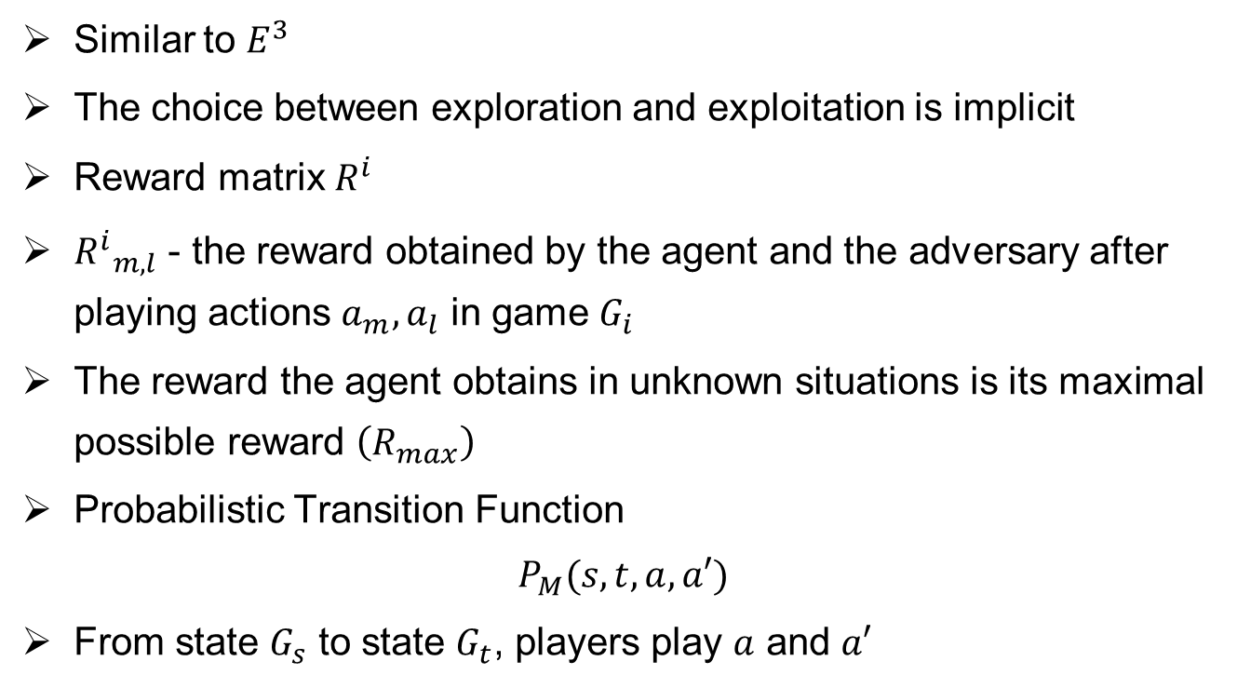
R-max
Similar to $E^{3}$
The choice between exploration and exploitation is implicit
Reward matrix $R^{i}$
${R^{i}}_{m,l}$ - the reward obtained by the agent and the adversary after playing actions $a_{m}, a_{l}$ in game $G_{i}$
The reward the agent obtains in unknown situations is its maximal possible reward $\left(R_{max}\right)$
Probabilistic Transition Function
$$P_{M}(s,t,a,a′)$$
From state $G_{s}$ to state $G_{t}$, players play $a$ and $a′$

Slide 7
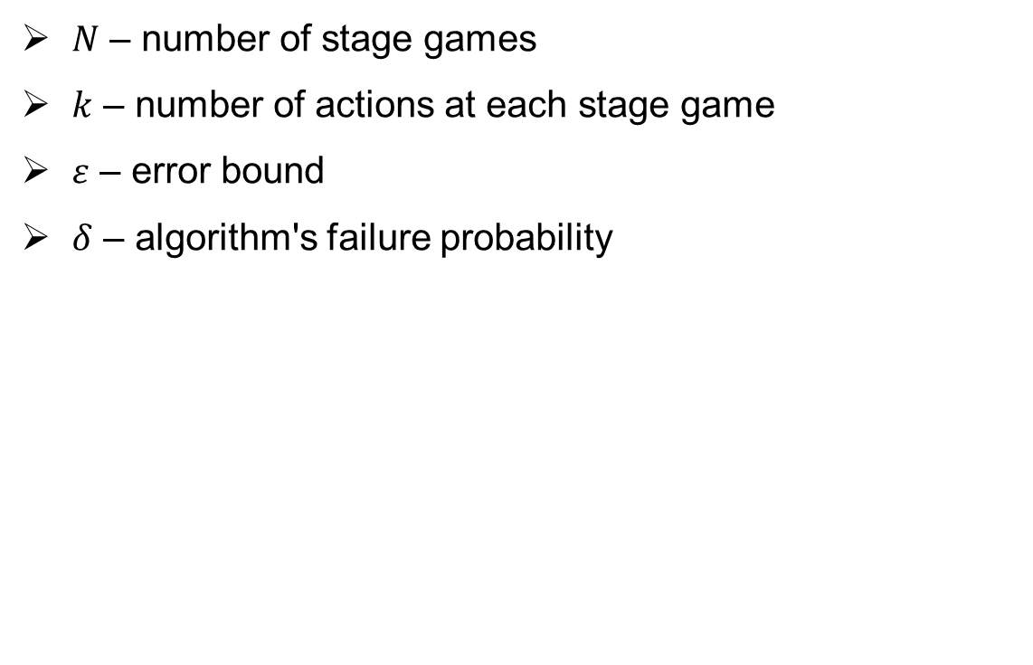
R-max - Input
  $N$ – number of stage games
  $k$ – number of actions at each stage game
  $ε$ – error bound
  $δ$ – algorithm's failure probability

Slide 8
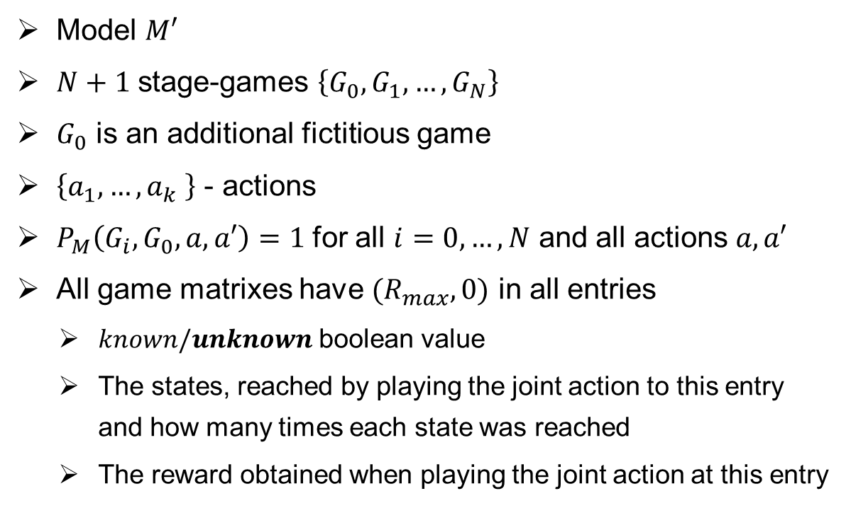
R-max - Initialize
  Model $M′$
  $N+1$ stage-games $\left\{G_{0}, G_{1}, …,G_{N}\right\}$
  $G_{0}$ is an additional fictitious game
  $\left\{a_{1},…,a_{k} \right\}$ - actions
  $P_{M}\left(G_{i},G_{0},a,a′\right)=1$ for all $i=0,…,N$ and all actions $a,a′$
  All game matrixes have ${(R}_{max},0)$ in all entries
    $known/unknown$ boolean value
    The states, reached by playing the joint action to this entry and how many times each state was reached
    The reward obtained when playing the joint action at this entry

Slide 9
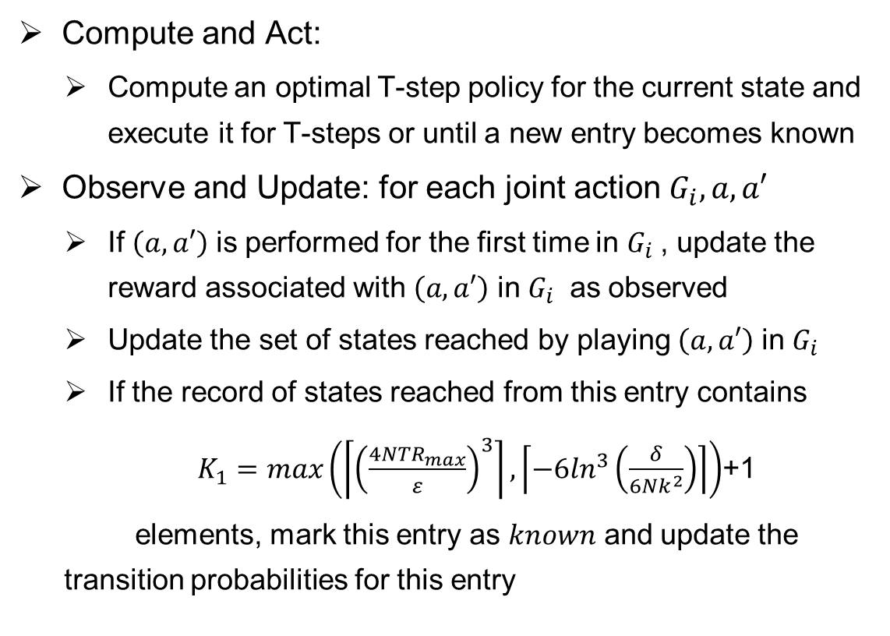
R-max, Repeat
Compute and Act:
    Compute an optimal T-step policy for the current state and execute it for T-steps or until a new entry becomes known
  Observe and Update: for each joint action $G_{i}, a, a′$
    If $\left(a,a′\right)$ is performed for the first time in $G_{i}$, update the reward associated with $\left(a,a′\right)$ in $G_{i}$ as observed
    Update the set of states reached by playing $\left(a,a′\right)$ in $G_{i}$
    If the record of states reached from this entry contains
    $K_{1}=max\left(\left\lceil {\left(\frac{4NTR_{max}}{ε}\right)}^{3}\right\rceil ,\left\lceil −6\ln^{3}\left(\frac{δ}{6Nk^{2}}\right)\right\rceil \right)$+1
    elements, mark this entry as $known$ and update the transition probabilities for this entry

Slide 10
R-max
Optimal policy has a very useful property with respect to the real model:
    It is always either optimal or it leads to efficient learning.
  The agent will not know whether it will optimize its behavior or it will learn efficiently, this depends on the adversary.
  Polynomial number of parameters to learn → the agent spends a polynomial number of steps exploring, the rest – exploiting.

Slide 11
Implicit exploit or explore
The agent will either attain near-optimal average reward or will update its statistics for one of the unknown slots with sufficiently high probability.
The agent does not know ahead of time whether it is exploring or exploiting – this depends in a large part on the adversary`s behavior.

Slide 12
Implicit exploit or explore
Our behavior is biased towards exploration, because of the appealing value of unknown states.
The value of the exploration policy in our fictitious model is very high, a probabilistic maximin.
The adversary cannot prevent us from attaining it.
If the adversary tries to prevent us from learning new information, we remain in known states; they are modeled correctly and their value is correct.
This value is near-optimal.

Slide 13
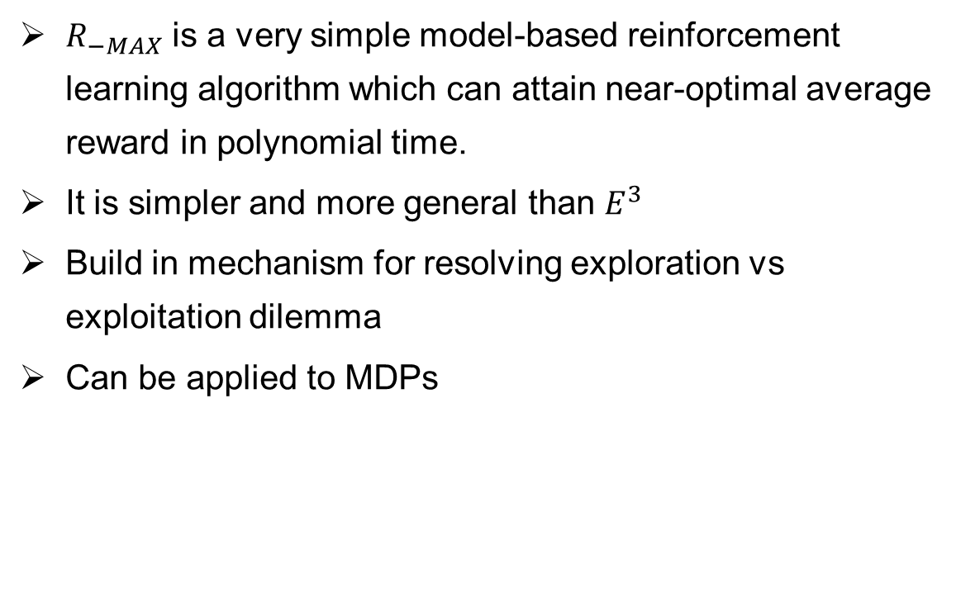
Conclusion
$R_{−MAX}$ is a very simple model-based reinforcement learning algorithm which can attain near-optimal average reward in polynomial time.
It is simpler and more general than $E^{3}$
Build in mechanism for resolving exploration vs exploitation dilemma
Can be applied to MDPs

Slide 14
Thank you for your attention!

Slide 15
Questions?

