Slide 1
Understanding the difficulty of training deep feedforward neural networks
Max Mindt
Many slides base on Glorot et al. [2010]

Slide 2
Aim of this paper
Understand better why deep neural networks are trained so poorly with gradient descent and random initialization
For that
Observe the influence of non-linear activation functions
Analyze how activations and gradients vary across layers
Propose a new initialization
Analyze the differences to standard initialization

Slide 3
Experimental Setting and datasets

Slide 4
Shapeset-3x2
Online Learning on an Infinite Dataset
3 Categories (parallelogram, triangle, ellipse)
Random Parameters (length, rotation, scaling, grey-scale,…)
Images with two objects
Classification task: predict the objects (e.g. triangle + ellipse)
  9 Classes

Slide 5
Finite Datasets
MINIST digits
50000 Images
10 Classes (airplane, automobile, bird, cat, ...)
Classification Task
Dataset was spited into:
Training
Validation
Test
30000
10000
10000
Training: Fit Parameters
Validation: Hyper-Parameter selection
Test: Estimate prediction error
Notes:
Other finite dataset: Small-ImageNet
All pictures are grey

Slide 6
Experimental Setting
Feedforward neural networks with
  one to five hidden layers (depth is an hyper-parameter)
  one thousand hidden units per layer
  softmax logistic regression for the output layer (multi-class prediction)
  negative log-likelihood as cost function
  Optimized with stochastic back-propagation on mini-batches
Notes:
More explanation about stochastic back-propagation on mini-batches

Slide 7
Experimental Setting
Initialization
All biases to be 0 and the weights
Search for each model
the best hyper-parameters: learning rate and depth
Varied the type of non-linear activation function
Sigmoid
Hyperbolic tangent
Newly proposed activation function: softsign
Notes:
n is the size of the previous layer
More explanation about the learning rate and depth?

Slide 8
Sigmoid
Range is 0 to 1
Non zero mean
Tails are exponential

Slide 9
Hyperbolic and Softsign
Similarities
Range is -1 to 1
Mean of 0
Differences
Tails of the softsign are quadratic polynomial
Tails of the hyperbolic are exponential

Slide 10
Effect of activation functions and saturation during training

Slide 11
Two things to avoid
Excessive saturation of activation functions
Gradient is close to zero
Backprop does not work well
No learnng
Overly linear units
Will not compute something interesting
Can be replaced by a single unit
Thanks to Jinseok Nam

Slide 12
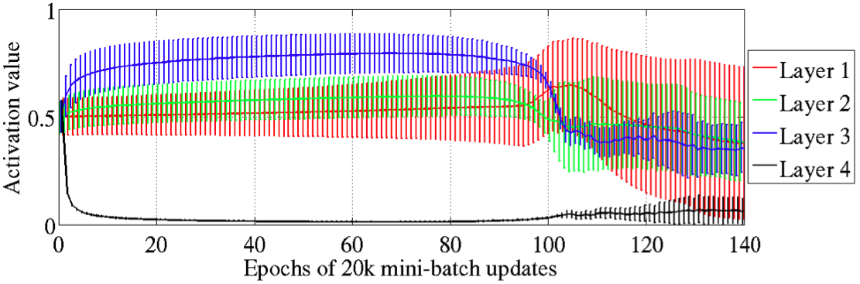
Experiments with the Sigmoid
Watching of saturation by monitoring activation values
escapes
Mean and standard deviation during learning
All the sigmoid activation values of layer 4 are close to 0
All other layers have a activation value above 0.5, and decreases from layer 3 to layer 1
Saturation can last very long
For four hidden layers, the saturation regime may be escaped
Notes:
Results on the Shapeset 3x2
Best depth on sigmoid is 4
Schaubild erklären: mean and standard deviations

Slide 13
Experiments with the Sigmoid
Why does layer 4 moves in saturation? A hypothesis
Remember: softmax for the output layer
Rely at the initialization more on its bias (learned quickly)
has at the beginning a high variance
The error gradient tend to push towards 0 (i.e. towards 0)
This leads to pushing sigmoid into saturation
(does not happen for hyperbolic and softsign because these have zero mean)

Slide 14
Experiments with the Sigmoid
Why does layer 4 moves out of saturation? A hypothesis
The layer 1 – 3 moves toward more useful features
Layer 4 moves out of saturation regime
Poorer quality

Slide 15
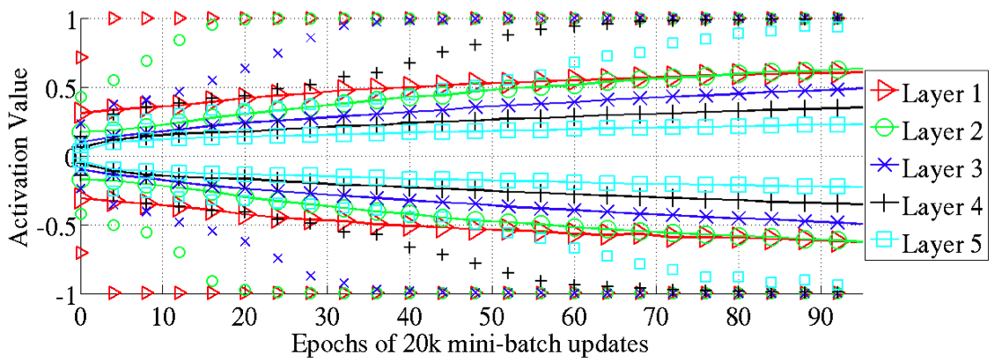
Experiments with the Hyperbolic
Layer 1 saturates
Layer 2 saturates
Layer 3 saturates
98 percentiles (markers alone) and standard deviation (solid lines)
Observation of a sequentially saturation phenomenon
First layer 1 saturates, layer 2 saturates, …
Why this happening remains to be understood
Notes:
Schaubild erklären: 98 perzentil = Q .98 ,d.h. es liegen 98 % der Fälle der Verteilung unterhalb dieses Punktes (nur markers)
Standardabweichung (solid lines with markers) der Aktivierungswerte
Mean liegt wohl in 0 ;) wegen Symmetrie

Slide 16
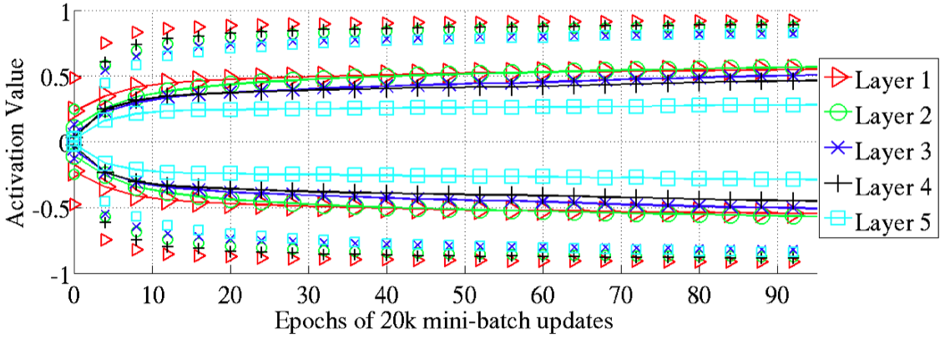
Experiments with the Softsign
98 percentiles (markers alone) and standard deviation (solid lines)
Behaves differently in terms of saturation (smoother asymptotes)
Saturation does not occur layer after layer
All layers move together
Faster at the beginning and then slow
Notes:
Schaubild erklären: mean and standard deviations

Slide 17
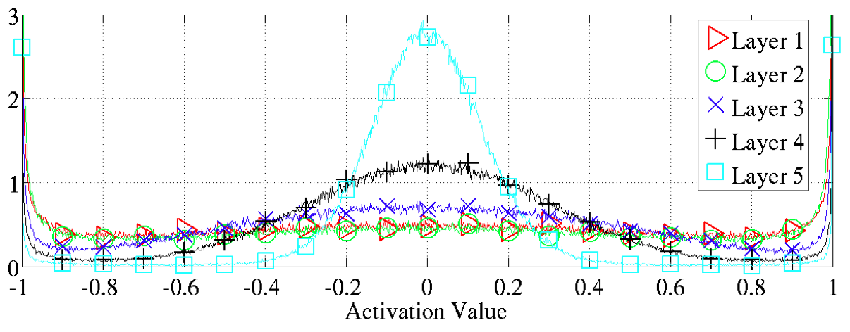
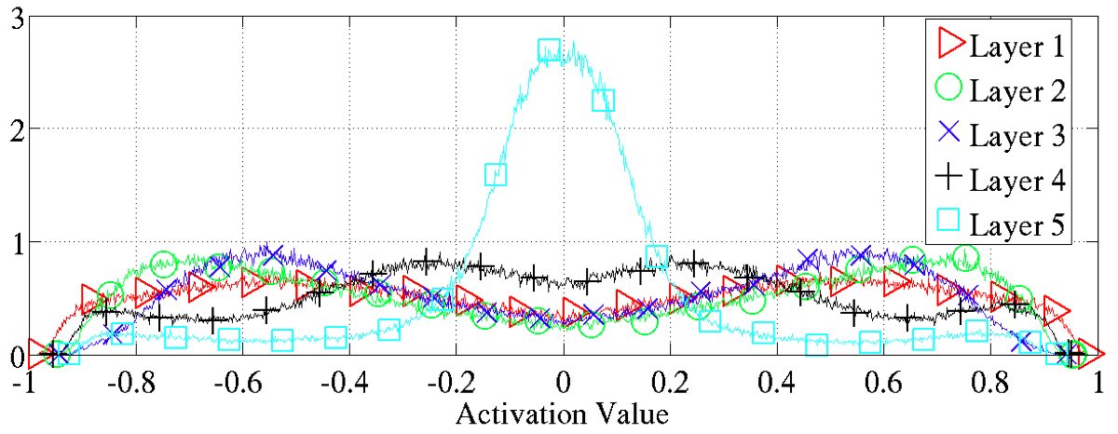
Activation values after training
Activation values normalized histogram, i.e. averaged across units of the same layer
Softsign has many activation values around (-0.8,-0.6) and (0.6,0.8)
saturates
Activation function is hyperbolic
Regions of non-linearity and where the gradients flow well
Activation function is softsign
Notes:
Problematik des Schaubilds erklären: Anzahl der Aktivierungswerte wurden gemittelt
Wo könnte man im Schaubild unten link überall Geraden hineinlegen?

Slide 18
Short Conclusion
Sigmoid is not appropriate because of its non zero-mean
Saturation can escape but moves in poorer quality
Unfortunately the hyperbolic moves also in saturation
Softsign works good because of its smoother asymptotes

Slide 19
Studying gradients and their propagation

Slide 20
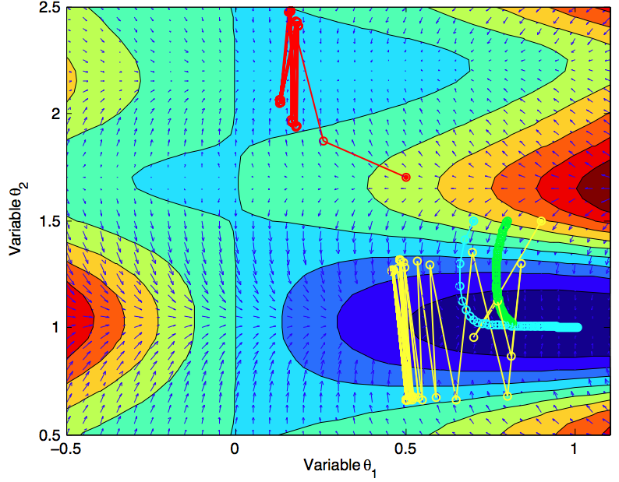
Cost Function
Many issues …
Initialization
Step size (= learning rate)
Iterations
Oscillation
Picture is from a homework assignment in
Maschinelles Lernen: Statistische Verfahren
Notes:
Bild soll lediglich Probleme veranschaulichen bei der Suche nach Minimas

Slide 21
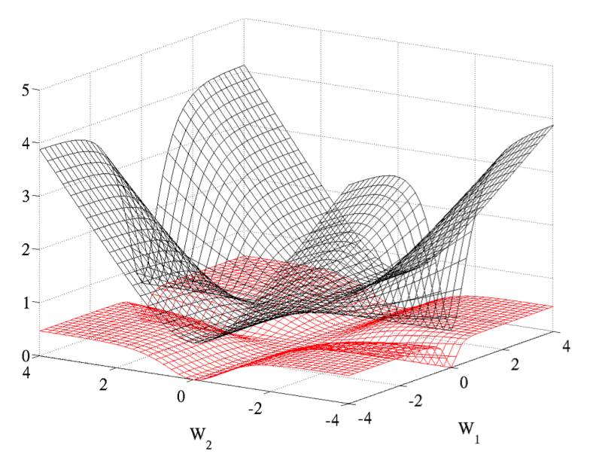
Conditional Log-likelihood vs. quadratic cost function
Quadratic cost function
Many plateaus
Get stuck in poor local minima
Traditionally used
Conditional Log-likelihood
Plateaus are less present
Works much better
However, the cost function with all weights is much more complicated

Slide 22
Derivation of a new initialization
Problem after initialization:
Back-propagated gradients decreases from output to input layer
Variance gets smaller
Nice to have: try to keep the information flowing
Forward-propagation: same variances of the input signal for all layers
Back-propagation: same variances of the gradients for all layers
Need to formalize the variance of
the activation vector at layer i
the gradients on the weight
the back-propagated gradient

Slide 23
Derivation of a new initialization
Back-propagated gradient
Based on Bishop et al. [2006]

Slide 24
Derivation of a new initialization
depends on the weight only via the summed input
Gradient on the weight
Based on Bishop et al. [2006]

Slide 25
Derivation of a new initialization
Consider following hypothesis at the initialization
Weights are initialized independently and have a zero expectation
Variance of the input features are the same
Variance of the activation vector
is the number of units at layer j
Notes:
Formel erklären

Slide 26
Derivation of a new initialization
Variance of the activation vector
A possible derivation
The above formula arises by recursive applying

Slide 27
Derivation of a new initialization
Variance of the back-propagated gradient
Variance of the gradient on the weight

Slide 28
Derivation of a new initialization
Nice to have: try to keep the information flowing
Forward-propagation:
Backward-propagation:

Slide 29
Derivation of a new initialization
Two new conditions
Transformed to
The conditions are fulfilled when all layers have the same width

Slide 30
Derivation of a new initialization
What we have
And we know for a uniform distribution [a,b] is
This leads to the so called normalized initialization

Slide 31
Properties of the variances
If all layers have the same width we can rewrite the variance of the back-propagated gradient
Still vanish or explode.

Slide 32
Properties of the variances
Also a new formulation for the variance of the gradient on the weights
Which is the same for all layers.

Slide 33
Gradient Propagation Study
Let’s try out how good is the normalized initialization against the standard initialization
For that we observe at the initialization
Activation values
Back-propagated gradients
Weight gradients (also during learning)

Slide 34
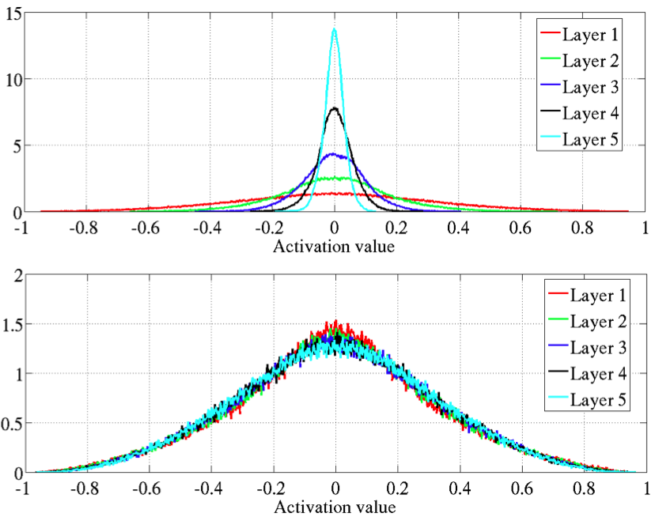
Gradient Propagation Study
How does the normalized initialization improve neural networks?
Forward-propagation:
“Try to keep the information flowing”
Activation values:
Top 0-peak increases for higher layers with standard initialization
Same activation values for all layers with normalized initialization
Standard initialization (top) vs. normalized initialization (bottom) with hyperbolic tangent activation
Notes:
Shapeset 3x2 obtain similar results with other datasets
Hyperbolic tangengt

Slide 35
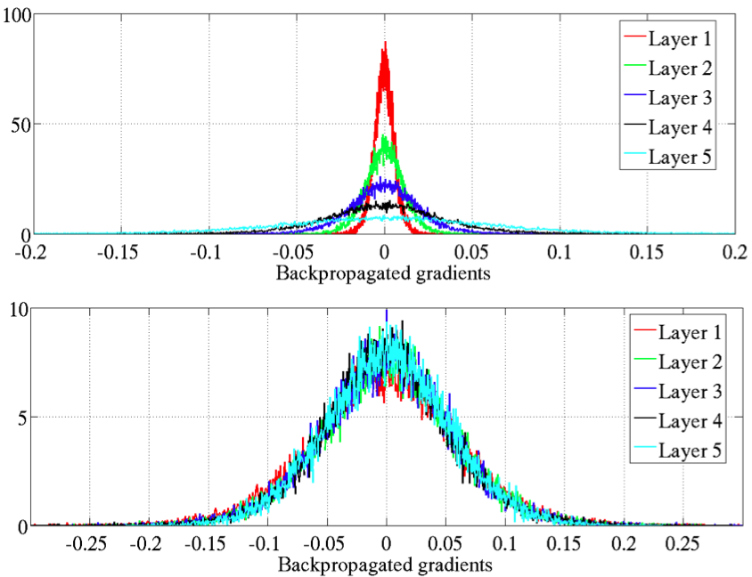
Gradient Propagation Study
How does the normalized initialization improve neural networks?
Back-propagation:
“Try to keep the information flowing”
Back-propagated gradients:
Top 0-peak decreases for higher layers with standard initialization
Variance of the back-propagated gradient is for all layers equals with normalized initialization
Standard initialization (top) vs. normalized initialization (bottom) with hyperbolic tangent activation

Slide 36
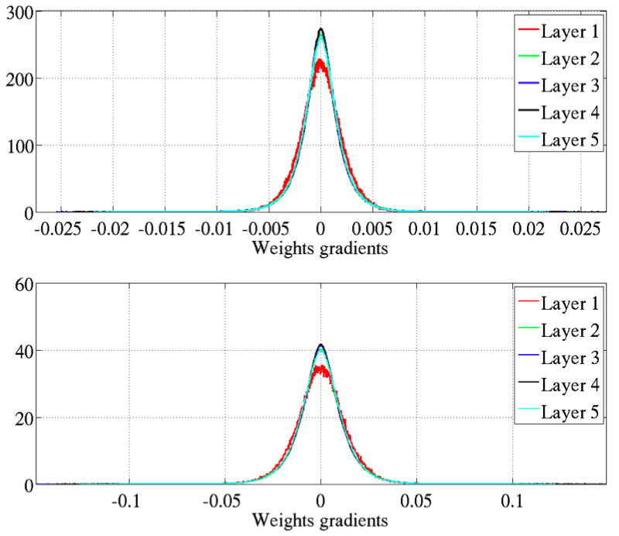
Gradient Propagation Study
How does the normalized initialization improve neural networks?
Variance of the weight gradients is constant
Was explained by
Standard initialization (top) vs. normalized initialization (bottom) with hyperbolic tangent activation

Slide 37
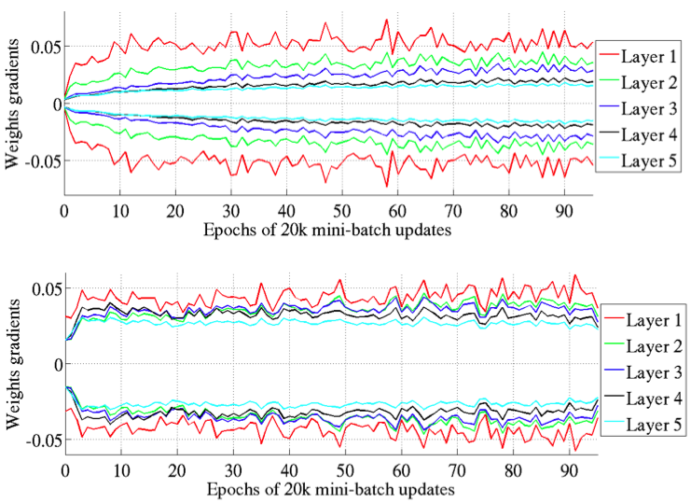
Gradient Propagation Study
How does the normalized initialization improve neural networks?
During learning:
Gradients diverge from each other with standard initialization
Normalization initialization has the same variance of the weight gradients
One more advantage of normalization initialization
Standard initialization (top) vs. normalized initialization (bottom) with hyperbolic tangent activation

Slide 38
Error curves and conclusion

Slide 39
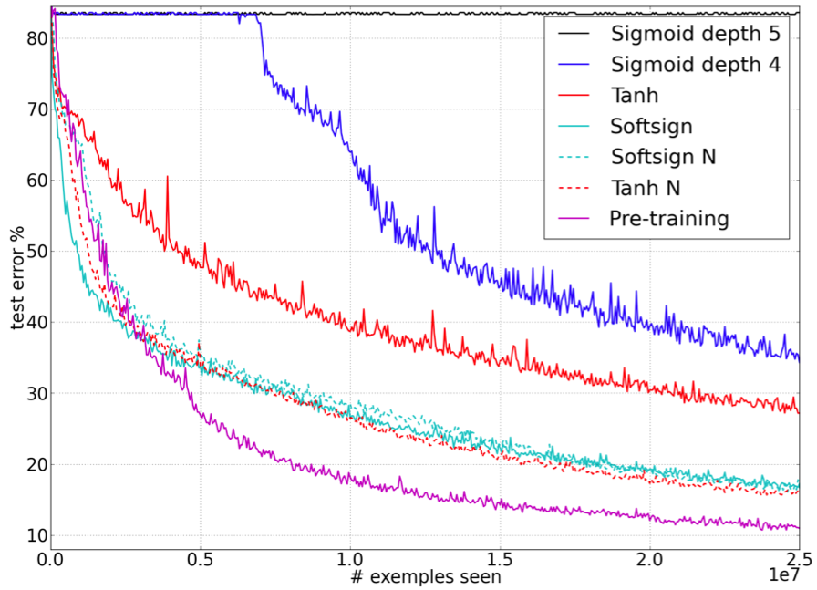
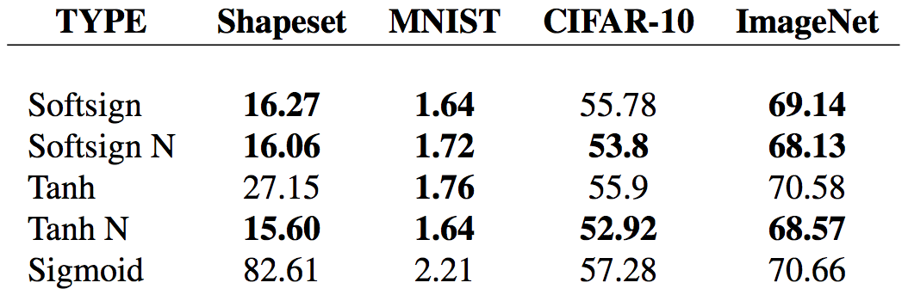
Error Curves and Conclusion
Classical neural networks are poorly, converging slowly and get stuck in poor local minima.
The softsign networks seem to be more robust to initialization procedure (gentler non-linearity)
For hyperbolic networks is the normalized initialization quite helpful
Monitoring activations and gradients during learning is a powerful tool

Slide 40
References
Glorot, X., & Bengio, Y. (2010). Understanding the difficulty of training deep feedforward neural networks. International Conference on Artificial Intelligence and Statistics. 249 – 256.
Bishop, C.M., & Nasrabadi, N.M. (2006). Pattern recognition and machine learning. Springer New York, 1, 241 – 245.

