Slide 1
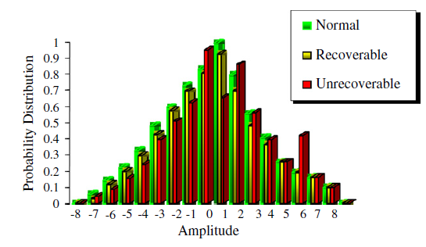
Multi-sensor data fusion using support vector machine for motor fault detection
Tribeni Prasad Banerjee, Swagatam Das

Slide 2
Outline
Introduction
The new hybrid fusion system
    STFT technique for signal classification
    Sensor fusion architecture
    Time duration based observer model
    SVM based fault detection techniques
An experimental case study
    Simulation results and discussion
Conclusion
Outlook

Slide 3
Introduction
Fusion
Sensor 1
Sensor 2
Sensor 3
Related information
“In standard sensor fusion architecture, data from more than one sensors and related
information from associated databases are combined to improve the accuracy levels as
well as to provide more specific inferences than what could be obtained by the use of a
single sensor.”

Slide 4
Introduction
Algebraic functions
Kalman filtering
weighted average
Bayesian estimators
adaptive observers
nonlinear system fusion
Especially for high performance operational systems sensor fusion techniques are still preferred and fuzzy logic, neural networks and soft computing
techniques can be applied for undertaking the fusion.
A new hybrid approach for multiple sensor data fusion and motor fault detection.
no previous knowledge is required about:
  sensor’s signal statistics
  system’s behavior
no learning or training processes are required.
Conventional approaches to sensor fusion
Hybrid approaches combining soft computing with the classical methods
This study:

Slide 5
The new hybrid fusion system
Outline
The new hybrid fusion system consists of the following four phases:
The signal is separated by STFT according to its frequency level and amplitude.
Next the system faults are modeled as changes in the sensor gain with the magnitude given by a nonlinear function of the measurable output and input signals. An adaptive time-based observer is proposed in order to monitor the system for unanticipated sensor failures.
Then a fusion block comes into play to combine the sensor data.
Finally the information provided by the previous two steps and the fused data is used to train the SVM (Support Vector Machine) classifier for fault-predictive system modeling.

Slide 6
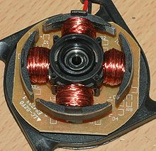
Side Note:
Brushless DC electric (BLDC) motor
General:
also known as electronically commutated motors (ECMs, EC motors)
synchronous motors that are powered by a DC electric source via an integrated inverter/switching power supply → produces an AC electric signal to drive the motor
Applications:
Transport (e.g. electric and hybrid vehicles, Segway Scooter, …)
Heating and ventilations
Industrial engineering
Motion control systems
Positioning and actuation systems
Model engineering
Radio controlled cars
https://upload.wikimedia.org/wikipedia/commons/thumb/6/6e/Poles.jpg/220px-Poles.jpg

Slide 7


Short-time Fourier transform (STFT) technique for signal classification
STFT is a Fourier-related transform used to determine the sinusoidal frequency and phase content of local sections of a signal as it changes over time
The Fourier transform (a one-dimensional function) of the resulting signal is taken as the window is slid along the time axis, resulting in a two-dimensional representation of the signal.
The idea behind the STFT is to segmenting the signal by using a time-localized window, and performing the analysis for each segment.
Since the Fourier transform is computed for every windowed segment of the signal, STFT is able to provide a true time–frequency representation.
In order to avoid complex-valued STFT, they use its squared magnitude, i.e., the spectrogram is defined as:
is signal of interest (voltage or a current from the Brushless DC electric motor) is the window function
= 0 for > T/2 and T is window width.

Slide 8
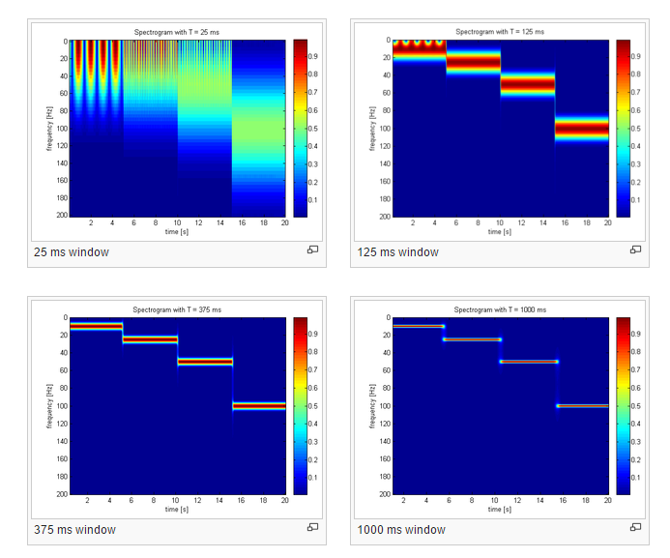
Short-time Fourier transform (STFT) technique for signal classification
Resolution issues:
fixed resolution
The width of the windowing function relates to how the signal is represented:
  good frequency resolution (frequency components close together can be separated)
  good time resolution (the time at which frequencies change).
wide window: better frequency resolution but poor time resolution.
narrower window: good time resolution but poor frequency resolution.
https://upload.wikimedia.org/wikipedia/commons/thumb/0/0f/STFT_colored_spectrogram_25ms.png/300px-STFT_colored_spectrogram_25ms.png

Slide 9
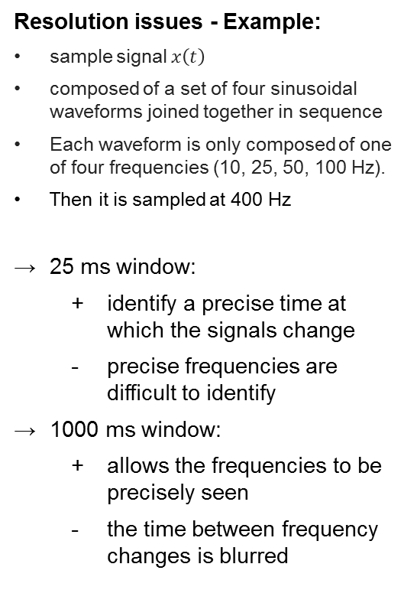
Short-time Fourier transform (STFT) technique for signal classification
Resolution issues - Example:
sample signal $x\left(t\right)$
composed of a set of four sinusoidal waveforms joined together in sequence
Each waveform is only composed of one of four frequencies (10, 25, 50, 100 Hz).
Then it is sampled at 400 Hz
25 ms window:
  identify a precise time at which the signals change
  precise frequencies are difficult to identify
1000 ms window:
  allows the frequencies to be precisely seen
  the time between frequency changes is blurred
https://upload.wikimedia.org/wikipedia/commons/thumb/0/0f/STFT_colored_spectrogram_25ms.png/300px-STFT_colored_spectrogram_25ms.png

Slide 10
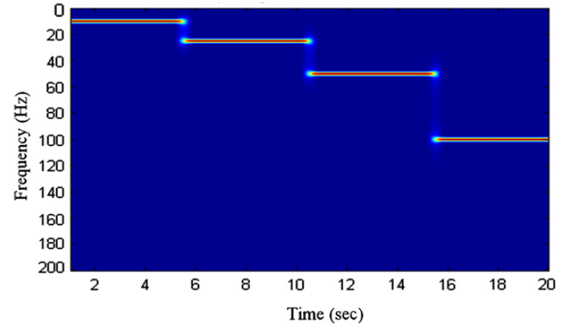

Short-time Fourier transform (STFT) technique for signal classification
Fig. 1 shows the different levels of frequency of signal that can be classified by the STFT techniques
This signal data has been taken by only one set of sensors; no data fusion being previously performed
Later they discuss how the hybrid approach enhances performance of the classification of the signal.
The problem with STFT is that it provides a constant resolution for all frequencies since it uses the same window for the analysis of the entire signal
The proposed hybrid method can overcome this problem
  the band of the various frequency levels are used as various threshold selections
  the time span gives for enhancing the effectiveness of the information fusion to enhance the fault detection techniques in high speed motor signal analysis

Slide 11
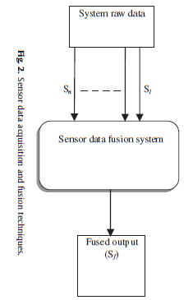
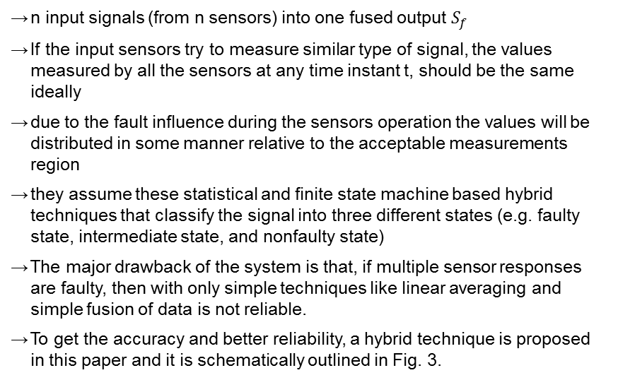
Sensor fusion architecture
General fusion techniques
n input signals (from n sensors) into one fused output $S_{f}$
If the input sensors try to measure similar type of signal, the values measured by all the sensors at any time instant t, should be the same ideally
due to the fault influence during the sensors operation the values will be distributed in some manner relative to the acceptable measurements region
they assume these statistical and finite state machine based hybrid techniques that classify the signal into three different states (e.g. faulty state, intermediate state, and nonfaulty state)
The major drawback of the system is that, if multiple sensor responses are faulty, then with only simple techniques like linear averaging and simple fusion of data is not reliable.
To get the accuracy and better reliability, a hybrid technique is proposed in this paper and it is schematically outlined in Fig. 3.

Slide 12
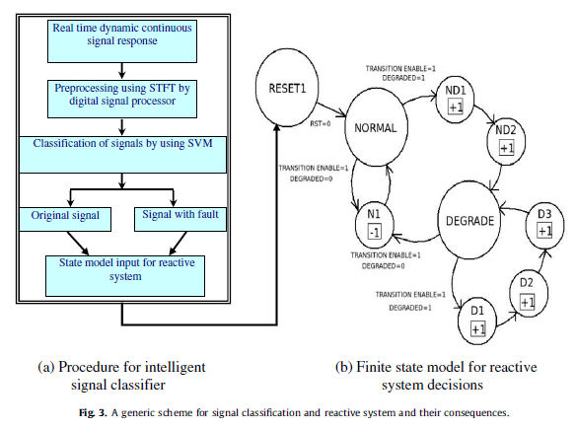
Time duration based observer model
FSM based system has an intermediate state (NORMAL to FAULT) before its going to fail completely
Time duration based model for fault signal monitoring (Altintas) and signal classification techniques (Roychoudhury et al.)
To overcome the shortcommings of the STFT-based signal classification techniques:
  Time duration based observer sensing system that monitors the duration of the feedback system
Observer measure and counts how many times the system response signal undergoes a typical temporal change
Counts of the observer cross its threshold:
  System gives an alarm feedback that indicates some incipient fault inside the model
The sensor sensing the signal after the processing the raw data by the STFT output

Slide 13
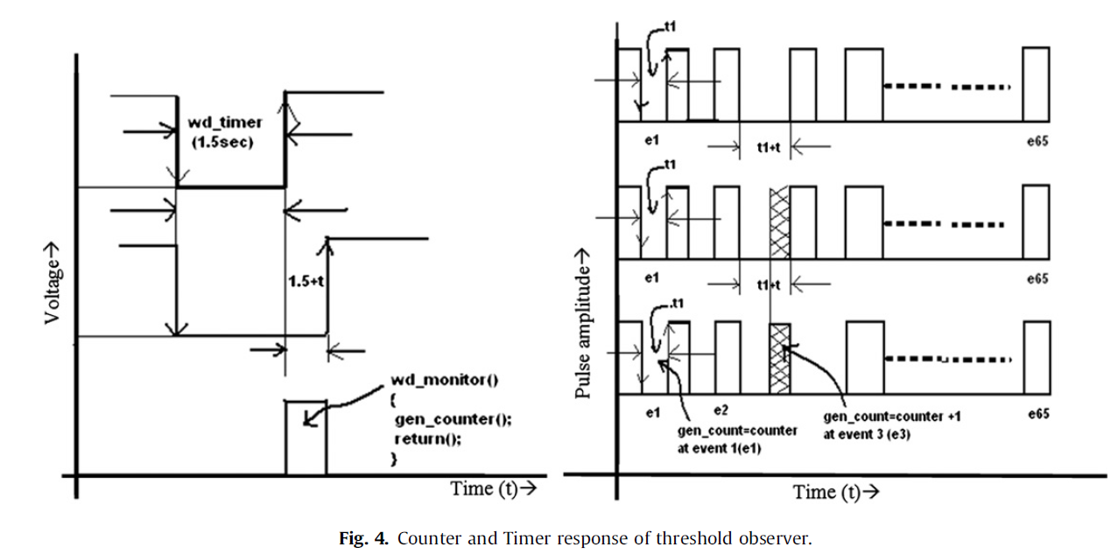
Time duration based observer model
Next the time duration observer, observes the timing response and the counter counts the value how many times the signal gives the unwanted response (i.e. crosses the threshold shown in Fig. 4)
Advantage of this method:
  Detailed list of the failure modes is not required and the failure can be estimated on the basis of as online diagnostic process
This implies an online diagnostic scheme instead of test inputs
The proposed state machine model takes the degraded functioning mode of a component for real time operating condition

Slide 14
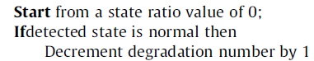
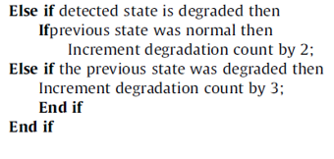
Time duration based observer model
Finite state machine model
Two main parameters for changing from one state to another
The triggering condition for each state depends on an event called TRANSITION (1 or 0), and DEGRADED (1 or 0)
They can observe and count any unwanted failure state inside the system

Slide 15
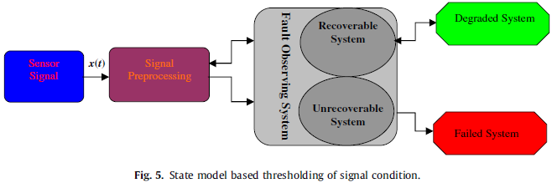
Time duration based observer model
Finite state machine model
Where a task is taken and that should executed within a predefined interval ‘‘d’’
System is not change his state within a certain interval of time: ‘‘Normal’’ state
It changes the state and not exceeds the interval (threshold): ‘‘Degraded state’’
Duration time exceeds the tolerance level: ‘‘Failed system’’.
The state model function ‘‘wd_monitor ()’’ monitoring this interstate changes:
wd_timer (): measures the time intervals
gen_counter (): counting the every degraded and feedback to the state model
The state machine based fault signal monitoring model, classifies a degraded and failed condition at the signal level
Notes:
Fig. 5: schematic model of the state machine based technique
Fig. 4: real time simulation (how the internal state observer counter counts the system response)

Slide 16
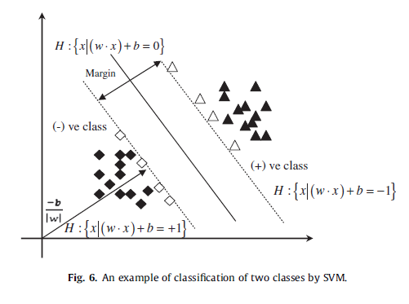

SVM based fault detection techniques
SVM is basically a statistical classifier this two types linear and nonlinear
In the case of linear in Fig. 6 shows that how to classify a series of points into two different classes of data class A (triangles) and class B (squares).
nonlinear signal decision function

Slide 17
SVM based fault detection techniques
In this paper: BLDC motor Condition - based maintenance (CBM) scheme by intelligent sensor fusion based faults signal identification and analysis along with SVM
Why SVM?
SVMs have the potential to handle very large feature spaces
SVM-based classifiers are claimed to have good generalization properties compared to conventional classifiers
When a signal falls outside the clusters, it is tagged as a potential motor failure
Since a fault condition is not a spurious event it can degrade the system, the postprocessor alarms the user only after multiple indications of a potential failure have occurred
In this way, the time duration modeling of the State machine is incorporated into the monitoring system and protects the reactive system by alarming on random signals that have been identified
Notes:
SVMs have the potential to handle very large feature spaces, because the training of SVM is carried out so that the dimension of classified vectors does not have as a distinct influence on the performance of SVM as it has on the performance of conventional classifiers.
This will also benefit in fault classification, because the number of features to be the basis of fault diagnosis may not have to be limited
, because in training the SVM classifier, the so-called structural misclassification risk is to be minimized, whereas traditional classifiers are usually trained so that the empirical risk is minimized

Slide 18
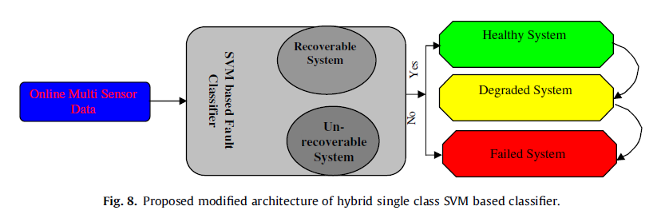
An experimental case study of the proposed hybrid fusion system
In the proposed architecture the online sensor data has been taken into the SVM based Fault classifier after its processed by Signal processing and Time duration based modeling
A threshold value need to be set between the healthy system, degraded and failed system.
However the threshold value varies with system and is difficult to determine, so for improve the performance of nonlinear behavior of the system they proposed the hybrid approaches
BLDC Motor operated highly precise controlled valve, which is used to controlling the environment
temperature inside the fight of the flight air condition system
An information fusion and long-period analysis method to improve the diagnosis performance technique has been applied to diagnose the compressor valve
However, these available techniques are not efficient in context of the nonlinear pattern recognition tasks

Slide 19
An experimental case study of the proposed hybrid fusion system
Hybrid signal processing and novel statistical data processing method
    the signal extracted as the failure indicator
    the SVM is employed to identify the failure pattern
    more the introduction of the proposed method can help experts have a high accuracy
The sensor signals are the raw signal to processing the signal and extract the signal using:
    STFT
    Thresholding by time duration modeling
    The SV classified data is fused with probability density distribution
The machinery operating condition can be detected by observing the shape of the probability distribution curve
As well known, when a certain failure occurs in the machinery, its signal spectrum changes accordingly:
    the vibration amplitude becomes larger with the degradation of the failure
    the proportion of the larger amplitude spectrum lines in the signal will be higher
    The probability density distribution curve changes from ‘‘peaky, thin’’ to ‘‘low, fat’’

Slide 20
An experimental case study of the proposed hybrid fusion system
The basic idea:
Transform input vectors into a high dimensional feature space using a nonlinear transformation
Then do a linear separation in feature space
In this proposed system:
Ninety sensors directly mounted vertically and horizontally at the valve body to measure the vibration signals at various valve position
Thousands continuous measurements were recorded for each condition
The maximum acquisition frequency was 50 Hz–10 kHz
Sampling number was 1200–16000
The valve opening and close time is very crucial for this application
    measuring the signal current and the speed of the motion of the motor controlling valve within a time limit
Main objective: Develop the safety critical intelligent system for the valve to monitor the opening and closing without failure
If within that time frame any unwanted situation occurs, then the system should give a prior alarm that may help in preventing any disaster

Slide 21
An experimental case study of the proposed hybrid fusion system
In the present study, an experimental test rig is used:
    Vibration responses for healthy bearing and bearing with faults are obtained
    All the simulations were carried out on a PC with Pentium IV processor of 1.6 GHz and 1 GB RAM
    Data acquisition and analysis system consists of Vibra-Quest software
    data were stored in a notebook computer
    LabVIEW for quick data acquisition, review and storage
    Data acquisition hardware consists of 16 analog input channels for simultaneous sampling
    All the results indicate that the proposed method is a valid analytic approach for the fault detection.

Slide 22
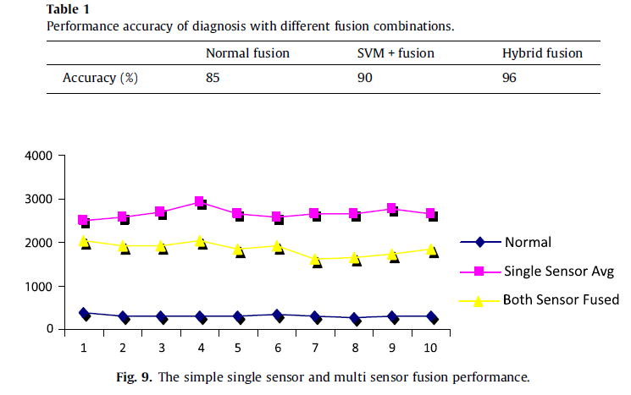
Simulation results and discussion
“In the case study of the system the results indicates that our hybrid approach is more suitable for real-time classifiers, for incipient faulty data and it can diagnose the developing faults well”
These indicate that Hybrid SVMs based fusion can identify the different severity of fault well and provide a better generalization performance compared to simple SVMs

Slide 23
Simulation results and discussion
Some time the single sensor type of data can gives a better results in the identifying the system behavior depending upon the time of iteration and cause of fatigue.

Slide 24
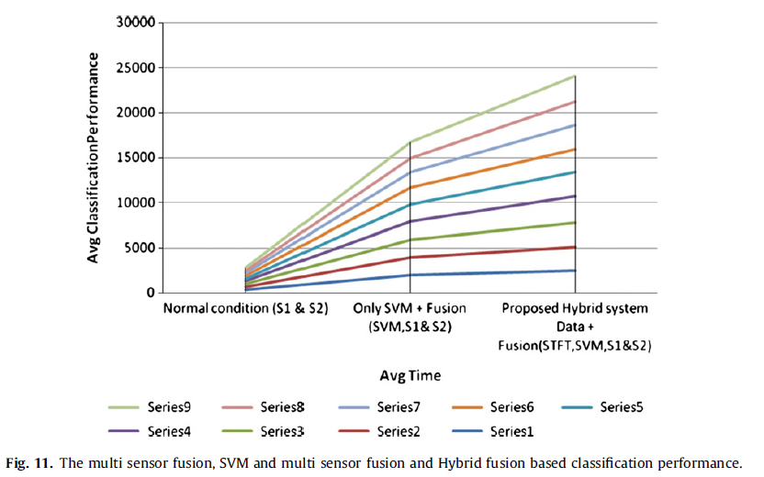
Simulation results and discussion
The average time for classification is increased, but as well as the percentage of average classification is also increased enormously which is more acceptable because it prevents the false alarm which is more dangerous in real world problem

Slide 25
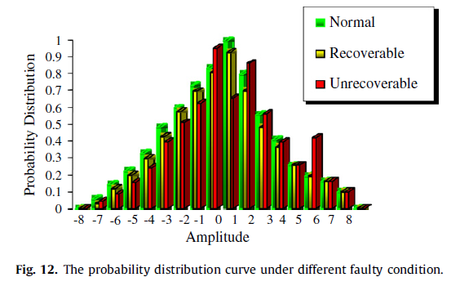
Simulation results and discussion
The probability distributions of the normal, recoverable, and unrecoverable systems

Slide 26
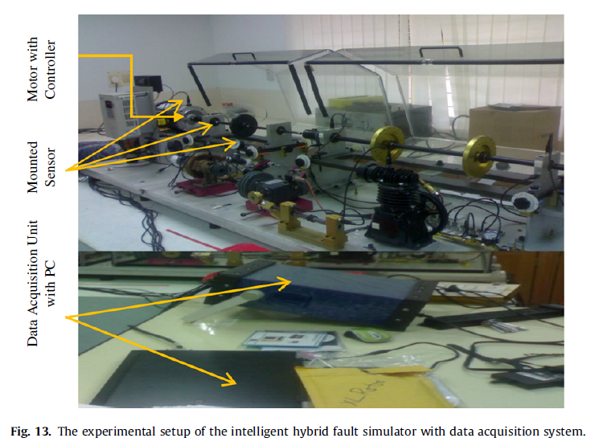
Simulation results and discussion
The test setup and the validation setup for case study

Slide 27
Conclusion
They suggested a hybrid control methodology of STFT based preprocessing of the random input sensor data classified by SVM and a timed automata based control
The status of the system parameter variations and sensor noise can identify more accurate and faster response time
So it improves the reliability and robustness of the system
The results have shown the high accuracy in nonlinear system
The model can be easily implemented and hence it can cause lower maintenance cost of the complex electro-mechanical system
The procedure reduces unwanted fault and unwanted shutdown without prior knowledge
The proposed system presents a modular approach to diagnosis of faults in aerospace Environment Control System (ECS) unit
With increase in the available sensory data, robustness of the system also exhibits a steady increase.

Slide 28
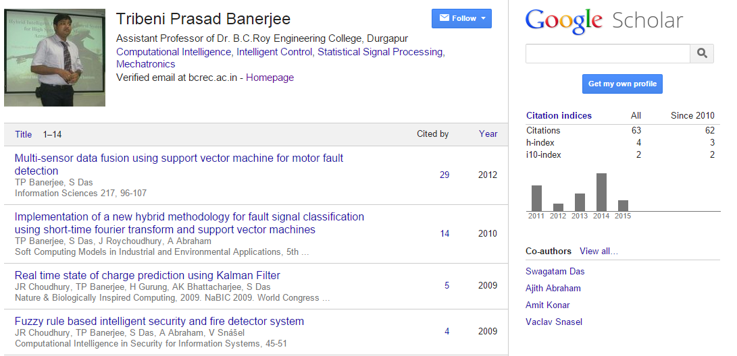
Outlook
“The first author continued this research under the CSIR-SRF”
https://scholar.google.com/citations?user=hXMJviwAAAAJ&hl=en

Slide 29
Discussion
CLARITY (1-5) | For the reasonably well-prepared reader, is it clear what was done and why? Is the paper well-written and well-structured?
ORIGINALITY (1-5) | Is there novelty in the developed application or tool? Does it address a new problem or one that has received little attention? Alternatively, does it present a system that has significant benefits over other systems, either in terms of its usability, coverage, or success?
IMPLEMENTATION AND SOUNDNESS (1-5) | Has the application or tool been fully implemented or do certain parts of the system remain to be implemented? Does it achieve its claims? Is enough detail provided that one might be able to replicate the application or tool with some effort? Are working examples provided and do they adequately illustrate the claims made?
SUBSTANCE (1-5) | Does this paper have enough substance, or would it benefit from more ideas or results? Note that this question mainly concerns the amount of work; its quality is evaluated in other categories.
EVALUATION (1-5) | To what extent has the application or tool been tested and evaluated? Have there been any user studies?
MEANINGFUL COMPARISON (1-5) | Do the authors make clear where the presented system sits with respect to existing literature? Are the references adequate? Are the benefits of the system/application well-supported and are the limitations identified?
IMPACT OF IDEAS OR RESULTS (1-5) | How significant is the work described? Will novel aspects of the system result in other researchers adopting the approach in their own work? Does the system represent a significant and important advance in implemented and tested human language technology?
RECOMMENDATION (1-5) | Should the paper be accepted or rejected?
REVIEWER CONFIDENCE (1-5)

Slide 30
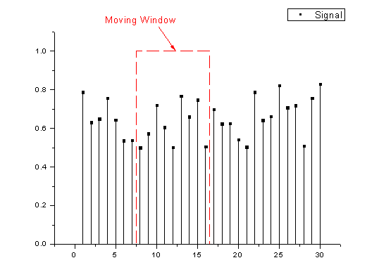
Appendix
Demonstration STFT: http://www.originlab.de/index.aspx?go=Products/Origin/DataAnalysis/SignalProcessing/STFT

