Slide 1
Development of smart sensors system for machine fault diagnosis
Paper by Jong-Duk Son , Gang Niu, Bo-Suk Yang, Don-Ha Hwang, Dong-Sik Kang
Jan Geukes

Slide 2
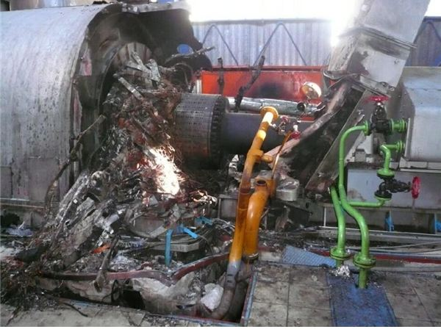
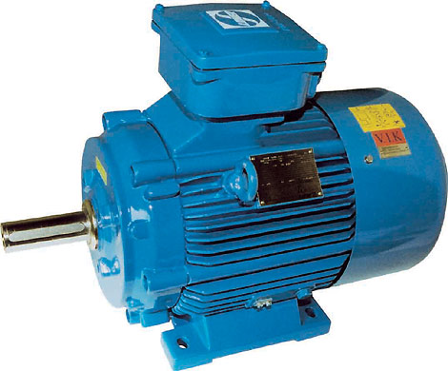
Domain and goal
Machine fault diagnosis (motors)

Slide 3
Agenda
What are smart sensors ?
Which machine learning methods are used ?
    Feature extraction
    Important classifier
    Introduction to SVM
  Comparison of conventional and smart sensors
  Results and conclusion

Slide 4
What are sensors ?
Sensing element
Signal conditioning and processing
Sensor interface
Transistors
Photodiodes
Capacitor
…
Filtering
Linearization
Compensation
…
Wires
Plugs
Connection to analyzer
…

Slide 5
Why do we need smart sensors ?
High costs of conventional sensors
Conventional sensors are very specialized
Wireless smart sensors – no cables
Goal:
    Can be used in a network
    Scalable
    Energy saving
    Programmable
    Reliable
    Accurate
    Cheap
Notes:
Nochmal neu
Ziel und vorteile klar trennen
Ziel der Arbeit darstellen

Slide 6
Goal of the paper
Build a smart sensor for a motor
Measure: flux, current and vibration
Use four classification methods
Compare the results with conventional sensors

Slide 7
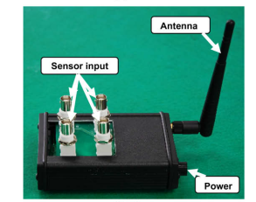
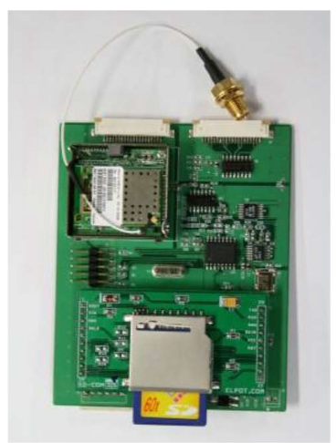
New smart sensor

Slide 8
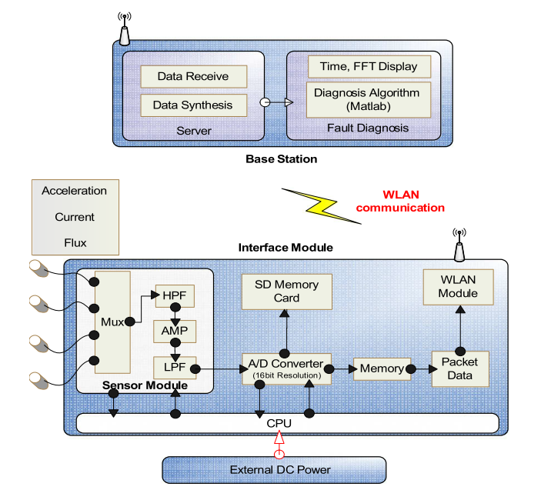
Smart sensor components

Slide 9
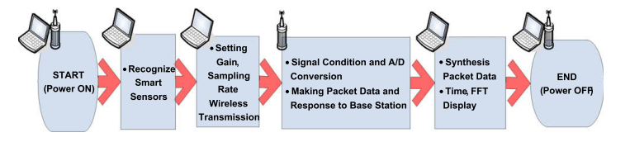
Flowchart Smart Sensor
Notes:
Selber bauen besser

Slide 10
Fault Diagnosis
Receive Data
Save Data
Calculate
Features
Feature Extraction
Division of Data
Data Training
Classification
Report of Results

Slide 11


Fault Diagnosis
Receive data from wireless smart sensors
Save the received data as ASCII file
Receive Data
Save Data
Calculate
Features
Feature Extraction

Slide 12
Fault Diagnosis – Calculate Feature
Mean
Shape factor
Histogram
Entropy error
Entropy estimation
RMS
Kurtosis
Auto regression coefficients
Skewness
Crest factor
Root mean square frequency
Frequency center
Root variance frequency
Receive Data
Save Data
Calculate
Features
Feature Extraction
Notes:
Features selber aufzählen

Slide 13
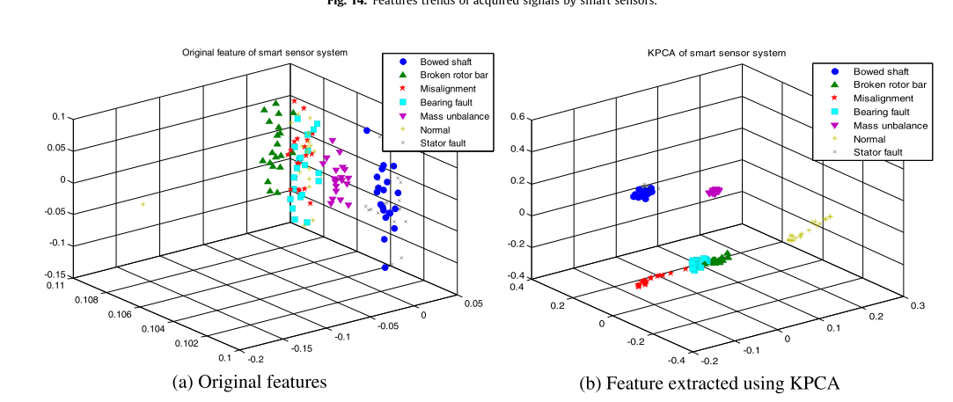
Fault Diagnosis - Feature Extraction
Receive Data
Save Data
Calculate
Features
Feature Extraction
Notes:
Features selber aufzählen

Slide 14
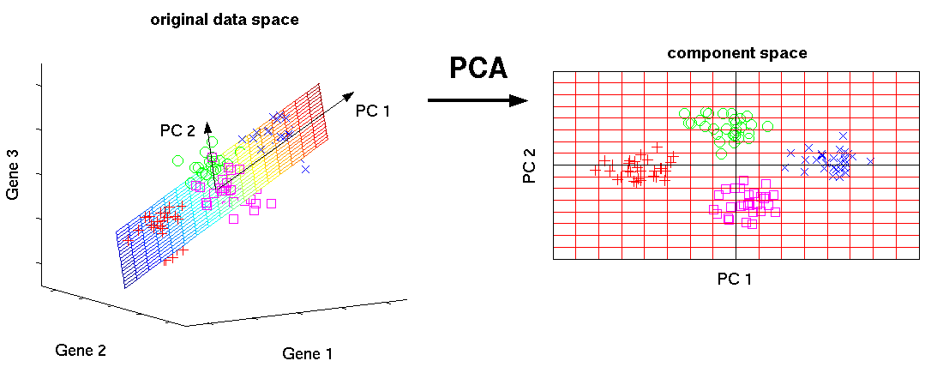

Fault Diagnosis – Principle Component Analysis
Goal: reduce dimensionality
Compute covariance matrix
Compute eigenvectors/values
Choose the k best eigenvectors
Transform data
http://sebastianraschka.com/Articles/2014_pca_step_by_step.html
Receive Data
Save Data
Calculate
Features
Feature Extraction
Notes:
Features selber aufzählen
http://sebastianraschka.com/Articles/2014_pca_step_by_step.html

Slide 15
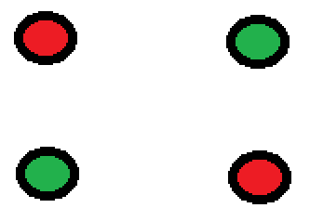

Fault Diagnosis – Kernel PCA (KPCA)
Principle Component Analysis is a linear operation
In general N points cannot be linearly separated in d < N dimensions
Almost always N points can be linearly separated in d ≥ N dimensions
First transform data with a kernel into another high dimensional space where it is possible to use PCA again
Receive Data
Save Data
Calculate
Features
Feature Extraction
Notes:
Features selber aufzählen
http://sebastianraschka.com/Articles/2014_pca_step_by_step.html
http://en.wikipedia.org/wiki/Kernel_principal_component_analysis

Slide 16
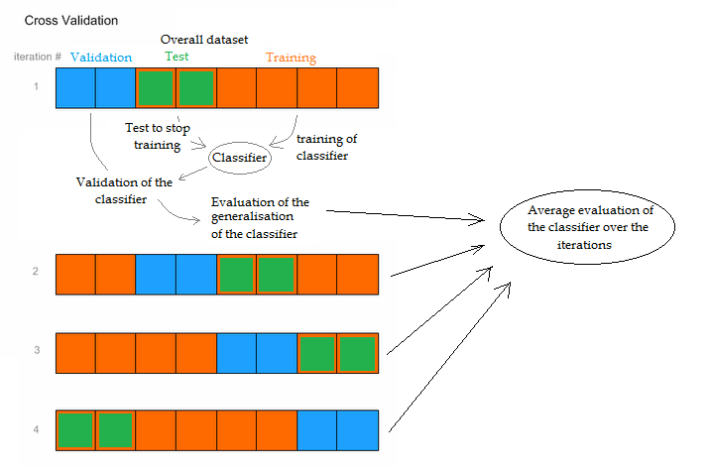
Fault Diagnosis – Cross Validation
http://www.intechopen.com/source/html/18993/media/image3.png
Division of Data
Data Training
Classification
Report of Results
Notes:
Quelle Pic

Slide 17
Fault Diagnosis – Training
SVM
Test
RF
KNN
Training Classifier
Cross Validation
LDA
Test
Training
Validation
Division of Data
Data Training
Classification
Report of Results
Notes:
Selber oder besser erklären
Klar machen das es die 4 Classifier gibt
ALL Supervised Methodes

Slide 18
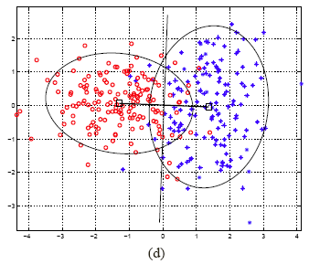
Classification – Linear Discriminant Analysis
Similar to PCA but uses class labels (supervised method)
Maximize the separation between multiple classes
But keep classes
Steps:
    Compute the mean for each class
    Compute the scatter matrices
    Compute the eigenvectors
    sort the eigenvectors
    Transform data into a new sub space
http://sebastianraschka.com/Articles/2014_python_lda.htm
Division of Data
Data Training
Classification
Report of Results
Notes:
http://sebastianraschka.com/Articles/2014_python_lda.htm

Slide 19
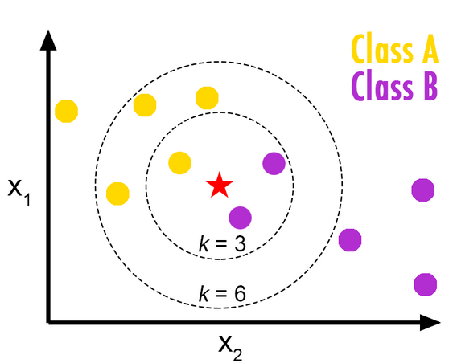
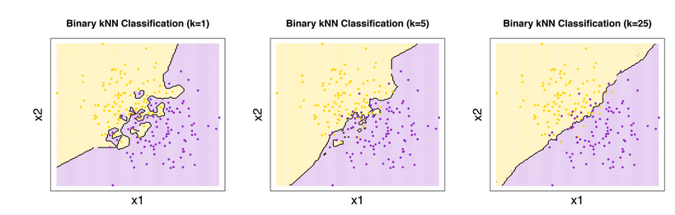
Classification – k-Nearest Neighbors
Majority vote in a certain area
How to chose k ?
How to measure distance ?
http://bdewilde.github.io/blog/blogger/2012/10/26/classification-of-hand-written-digits-3/
Division of Data
Data Training
Classification
Report of Results
Notes:
http://bdewilde.github.io/blog/blogger/2012/10/26/classification-of-hand-written-digits-3/

Slide 20
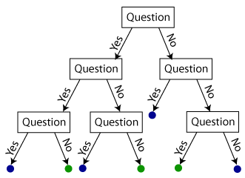
Classification – Random Forest
Many decision trees
Different strategies to split sub trees
Some kind of boosting
Majority vote like knn
https://shapeofdata.wordpress.com/2013/07/09/random-forests/
Division of Data
Data Training
Classification
Report of Results
Notes:
Selber oder besser erklären
Klar machen das es die 4 Classifier gibt
https://shapeofdata.wordpress.com/2013/07/09/random-forests/

Slide 21
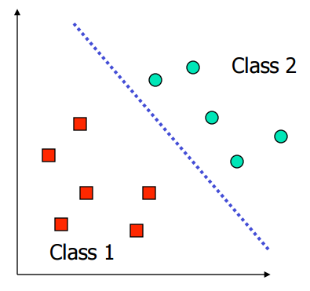
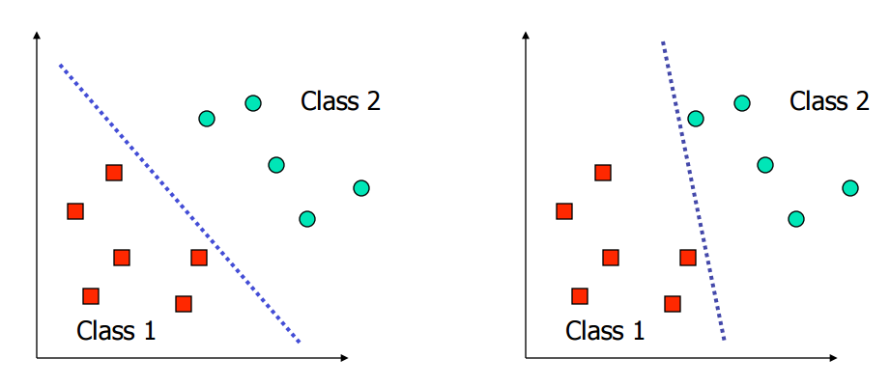
Classification – Support Vector Machine
Linear SVM - Idea
http://www.cs.columbia.edu/~kathy/cs4701/documents/jason_svm_tutorial.pdf
Division of Data
Data Training
Classification
Report of Results
Notes:
Selber oder besser erklären
http://www.cs.columbia.edu/~kathy/cs4701/documents/jason_svm_tutorial.pdf
Klar machen das es die 4 Classifier gibt

Slide 22
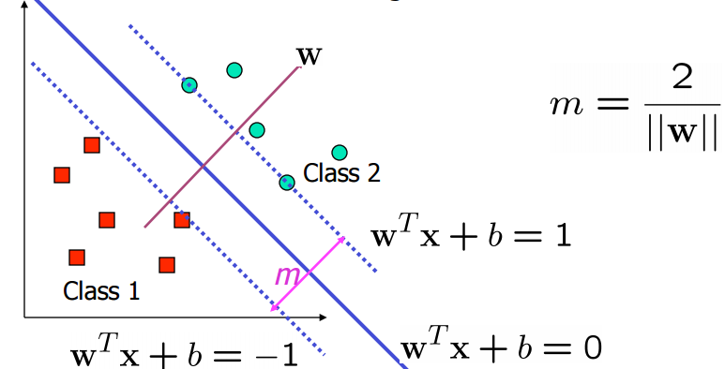
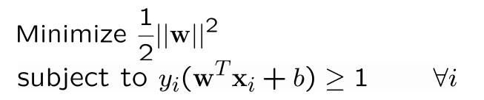
Classification – SVM
y = labels = {1,-1}
x = data points
Division of Data
Data Training
Classification
Report of Results
Notes:
Selber oder besser erklären
http://www.cs.columbia.edu/~kathy/cs4701/documents/jason_svm_tutorial.pdf
Klar machen das es die 4 Classifier gibt

Slide 23
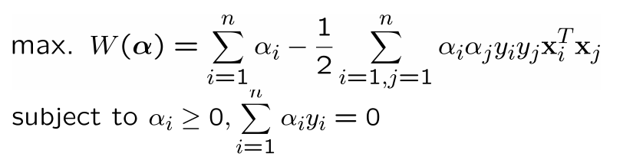
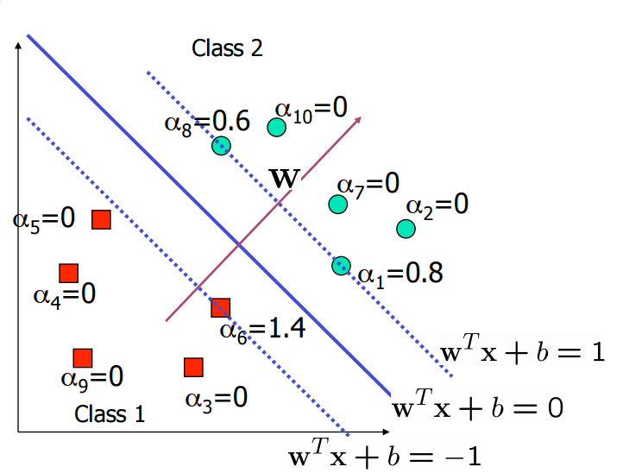
Classification – SVM - Dual Formulation
Quadratic Problem
Convex
Global Optimum
Division of Data
Data Training
Classification
Report of Results
Notes:
Selber oder besser erklären
Klar machen das es die 4 Classifier gibt

Slide 24
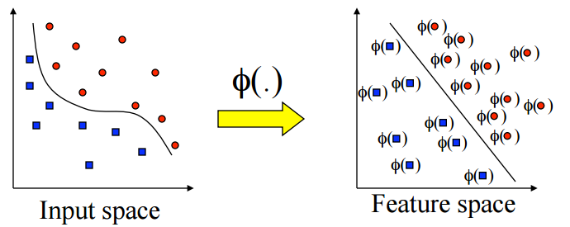

Classification – SVM – Non-linear
Kernel – Trick:
http://www.cs.columbia.edu/~kathy/cs4701/documents/jason_svm_tutorial.pdf
Division of Data
Data Training
Classification
Report of Results
Notes:
Selber oder besser erklären
Klar machen das es die 4 Classifier gibt

Slide 25


Classification – SVM – Kernel
Polynomial Kernel:
Radial basis function kernel:
Division of Data
Data Training
Classification
Report of Results
Notes:
Selber oder besser erklären
Klar machen das es die 4 Classifier gibt
http://www.cise.ufl.edu/class/cis4930sp11dtm/notes/intro_svm_new.pdf für vieles

Slide 26
Classification – SVM
Strengths
Training is relatively easy
No local optimal, unlike in neural networks
It scales relatively well to high dimensional data
Tradeoff between classifier complexity and error can be controlled explicitly
Weaknesses
Need to choose a “good” kernel function.
http://www.cs.columbia.edu/~kathy/cs4701/documents/jason_svm_tutorial.pdf
Division of Data
Data Training
Classification
Report of Results
Notes:
Selber oder besser erklären
Klar machen das es die 4 Classifier gibt

Slide 27
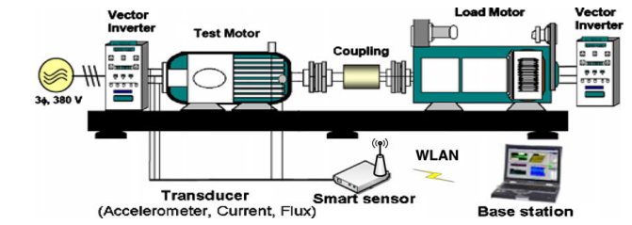
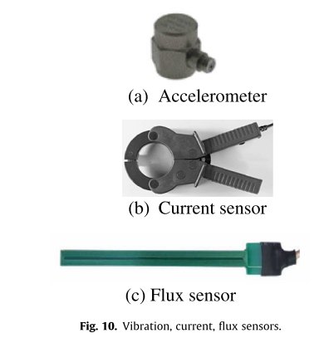
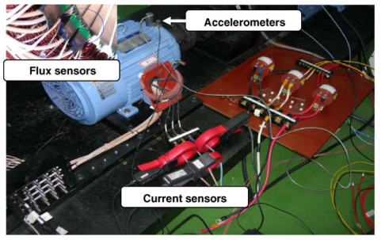
Experiment

Slide 28
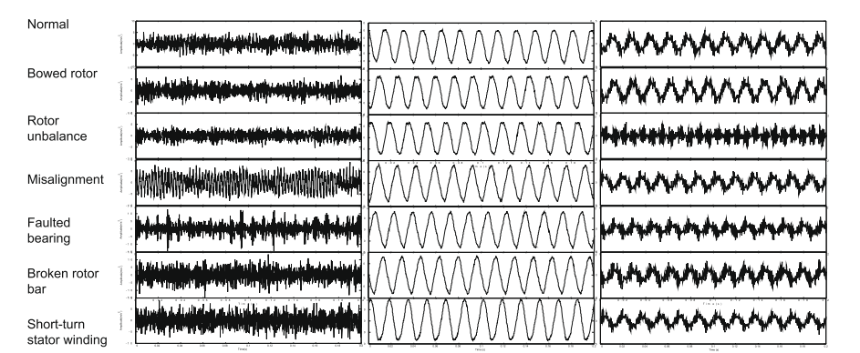
Test Objects
Vibration
Current
Flux
Normal
Broken rotor bar
Rotor unbalanced
Fault bearing
Misalignement
Bowed rotor
Short-turn stator winding

Slide 29
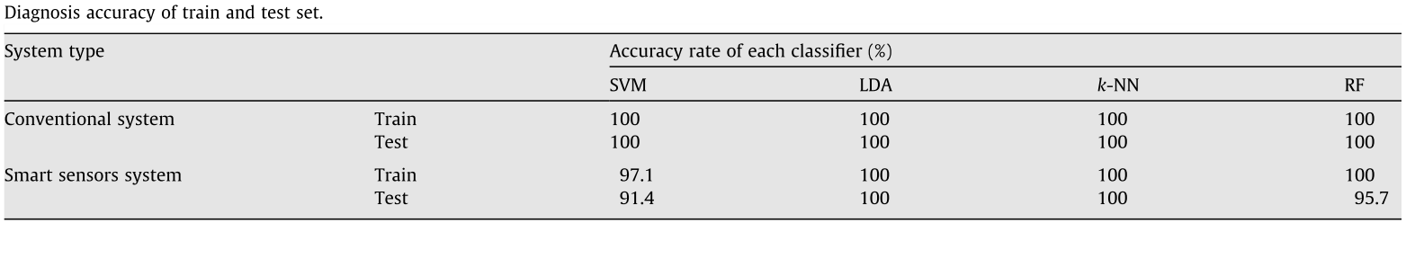
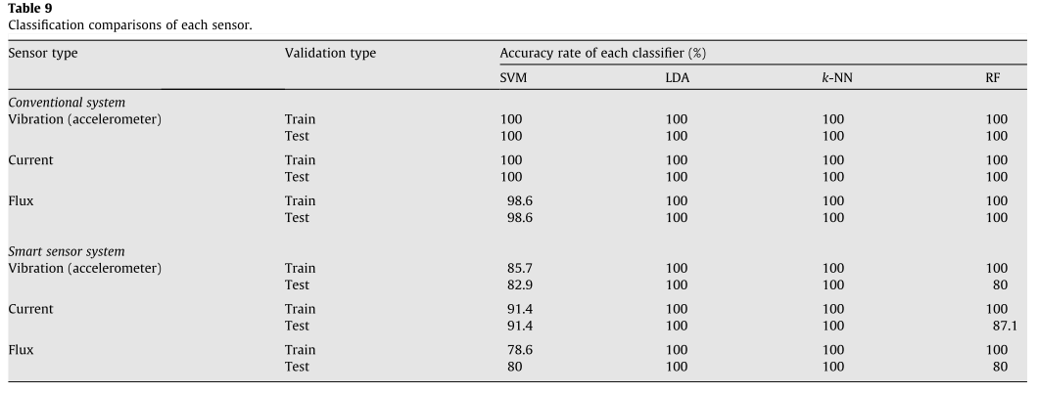
Results

Slide 30
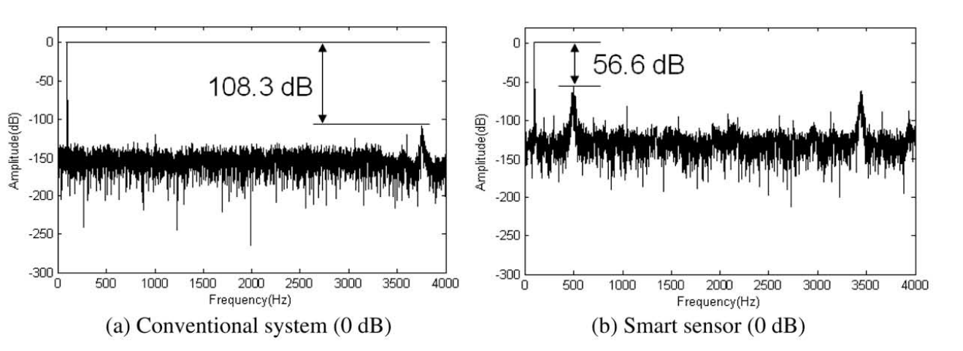
Performance Problems
Very good results with kNN and LDA
Problems with SVM and RF due to SNR (signal to noise ratio)
Lower ADC performance because of cheaper hardware
Appropriate signal amplitude is recommended

Slide 31
Conclusion
Build new Sensor
Lower costs
Very good results with kNN and LDA
Good over all performance in detecting problems
Problems with SVM and RF due to SNR (signal to noise ratio)
Future Work
Build a more compact Sensor
Work on the SNR problem
Try to make it even more cheaper

Slide 32
Thank you for your attention
Questions?

Slide 33
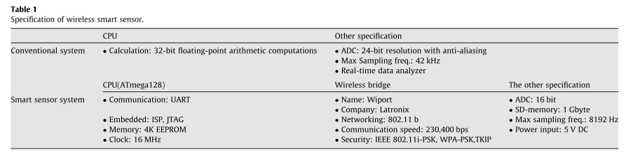
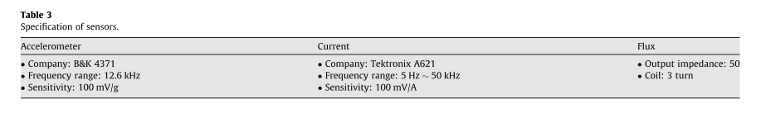

Slide 34


